Slide 1

CFD modelling for ethanol steam reforming for production of hydrogen DEPARTMENT OF CHEMICAL ENGINEERING BIRLA INSTITUTE OG TECHNOLOGY , MESRA ,RANCHI
To
Sangram roy
By Amartya Abhyankar
BTECH/10410/22

Slide 2
OBJECTIVE
Analyze how inlet velocity, ethanol concentration, and heat flux affect ethanol steam reforming.
Visualize and interpret temperature, ethanol, and hydrogen profiles using contour plots.
Identify conditions that maximize hydrogen yield in the reactor.

Slide 3
UPNEXT-
This section presents contour plots illustrating the spatial distribution of key variables in the ethanol steam reforming process under various operational conditions:
Temperature Distribution: Shows temperature gradients within the reactor, highlighting zones of heat input, reaction intensity, and heat loss.
Ethanol Concentration Profiles: Depict consumption rates and spatial depletion of ethanol as it reacts during the steam reforming process.
Hydrogen Concentration Profiles: Demonstrate hydrogen generation patterns, indicating where and how much hydrogen is produced throughout the reactor.
Each graph corresponds to specific experimental setups defined by inlet velocity, ethanol feed concentration, and heat flux parameters. The combined graphical analysis provides insight into reactor performance, efficiency, and optimal hydrogen production conditions.

Slide 4

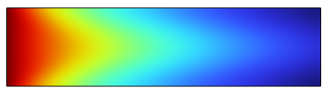


WITHOUT HEAT FLUX C_E=10 U=0.18 C_S=30
Temperature hydrogen concentration Ethanol concentration

Slide 5
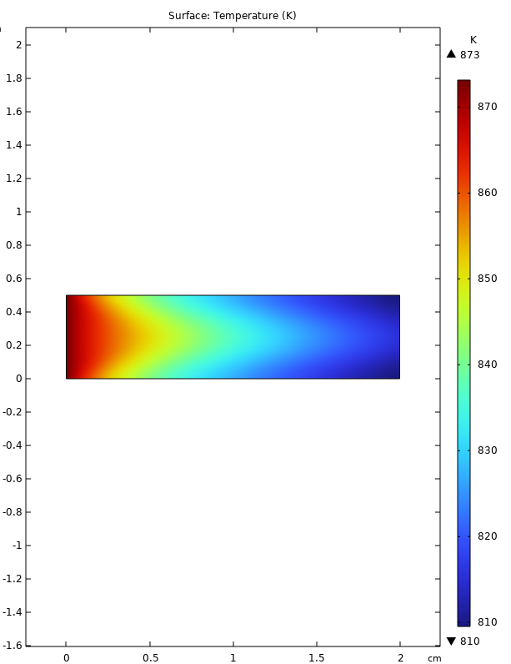
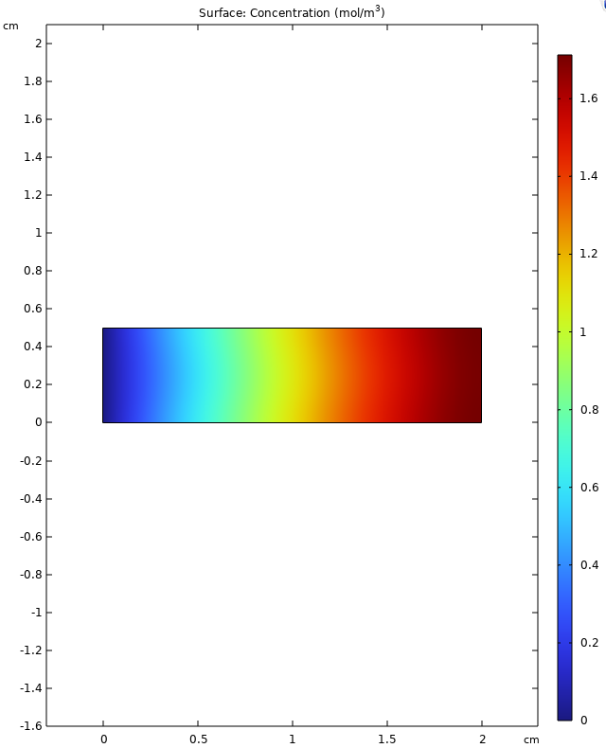
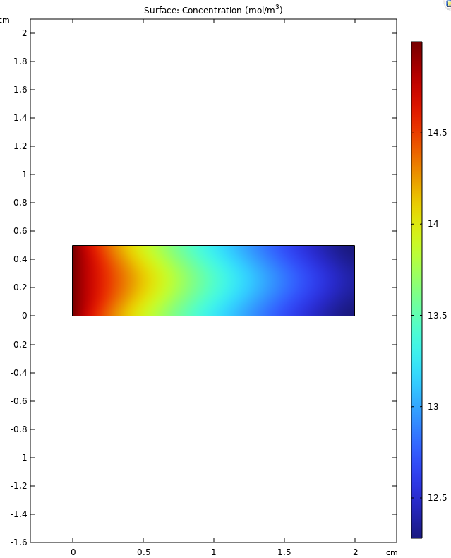
U=0.18, ethanol inflow =15 TEMPERATURE ETHANOL CONCENTRATION HYDROGEN CONCENTRATION

Slide 6
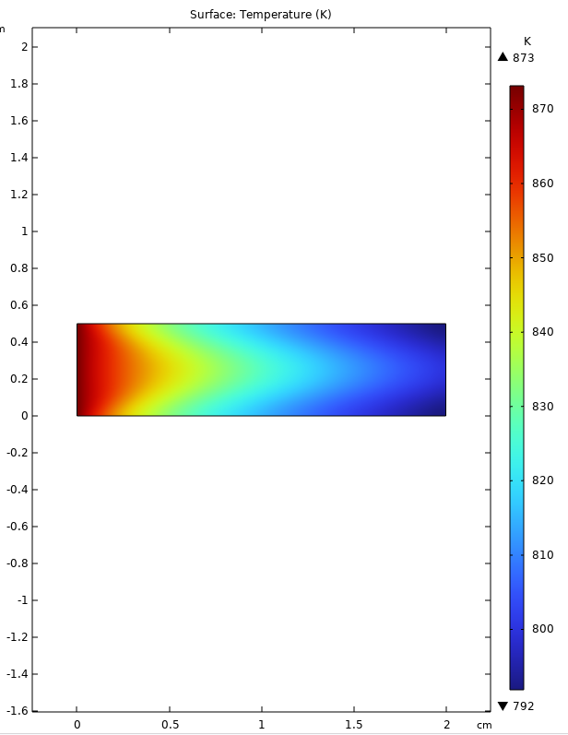
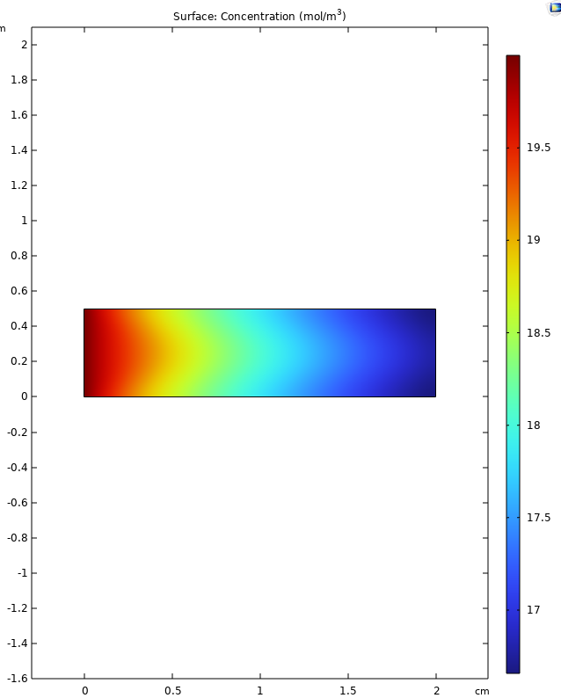
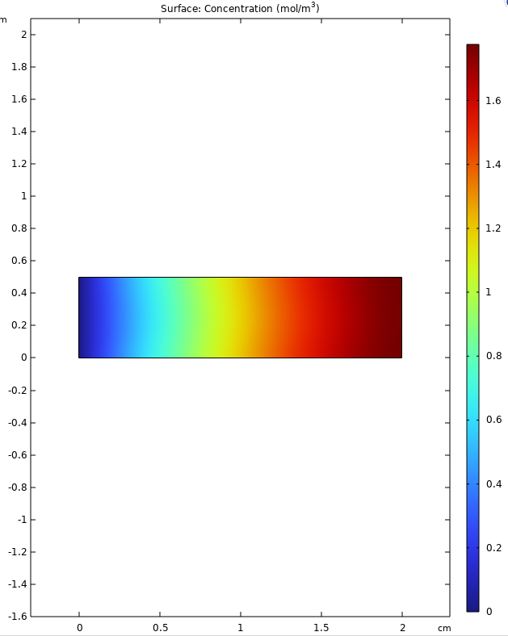
Ethanol inflow =20, u=0.18 TEMPERATURE ETHANOL CONCENTRATION HYDROGEN CONCENTRATION

Slide 7




C_E=10 U=0.36 C_S=30
Temperature hydrogen concentration Ethanol concentration

Slide 8
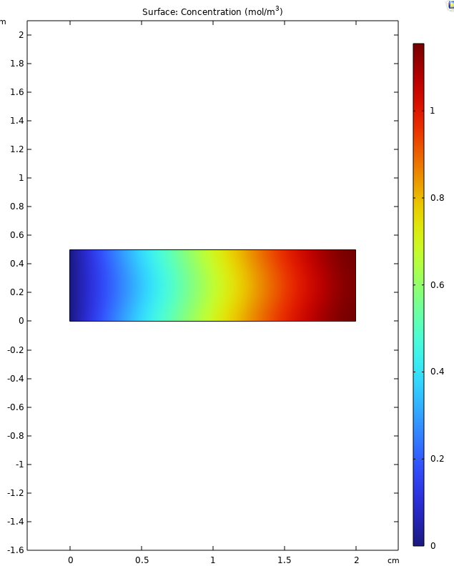
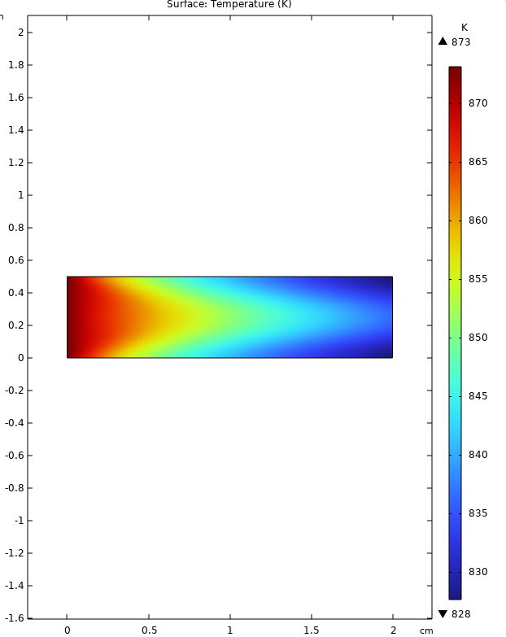
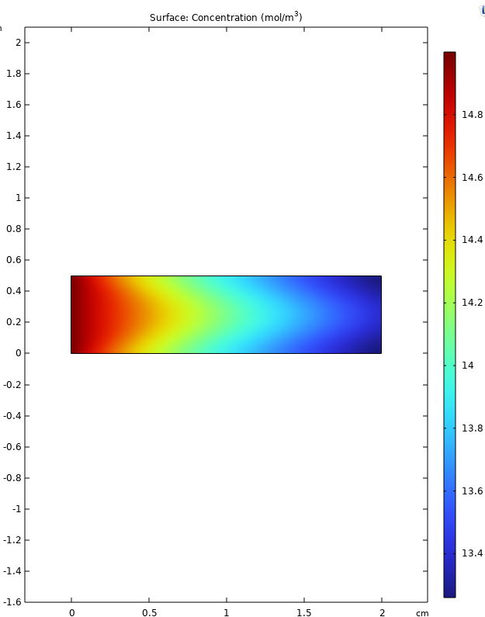
C_E=15 U=0.36 TEMPERATURE ETHANOL CONCENTRATION HYDROGEN CONCENTRATION

Slide 9
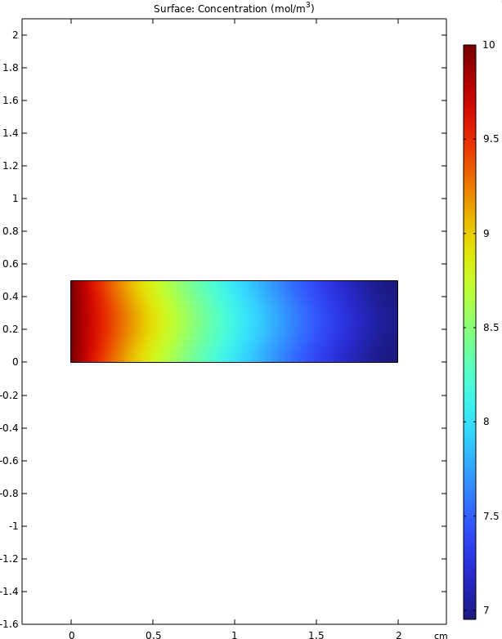
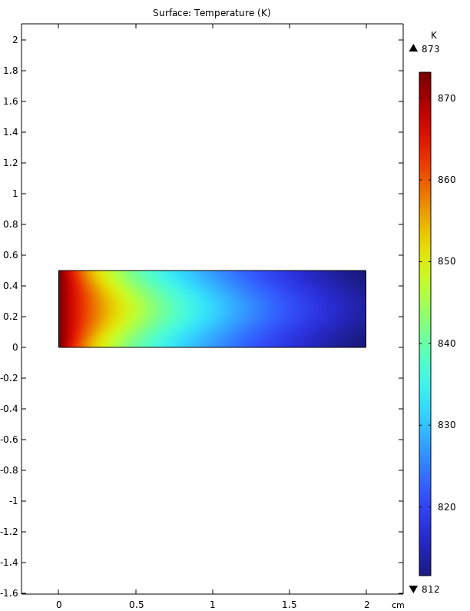
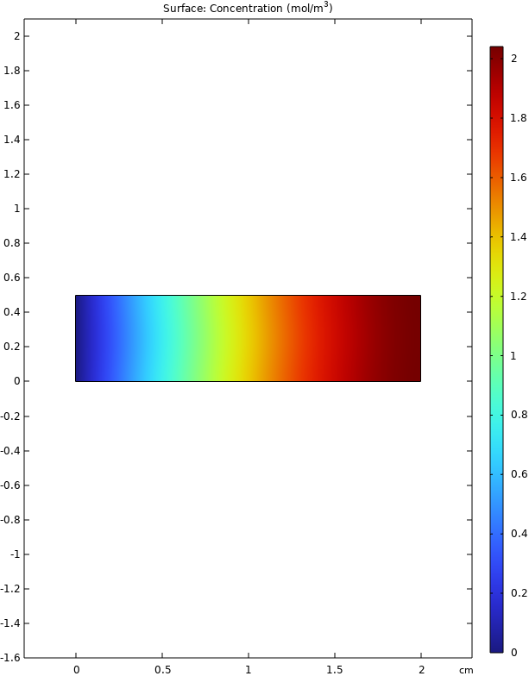
U=0.09 C_E=10 C_S=30

Slide 10
WITH HEAT FLUX GIVEN FLUX =100 W/m^2
u=0.18
C_E=10
C_S=30

Slide 11
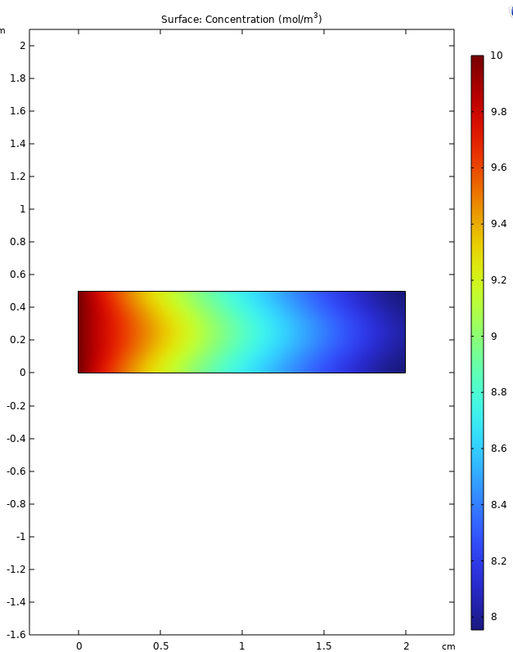
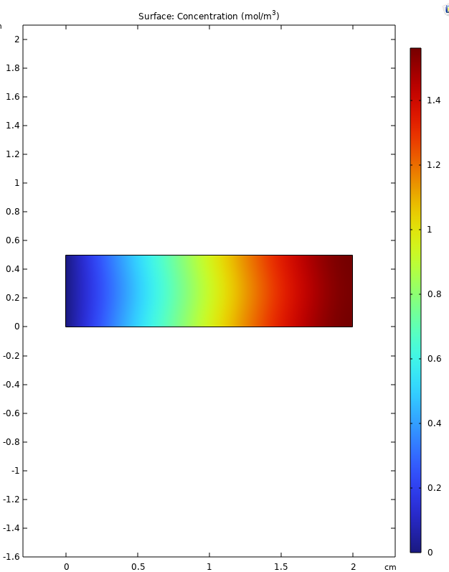
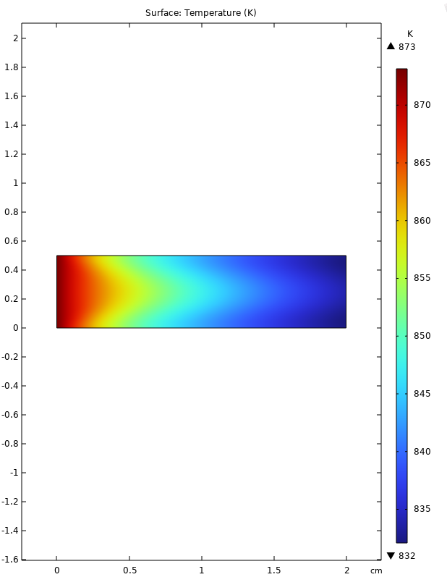
u=0.18 C_E=10 C_S=30
.

Slide 12
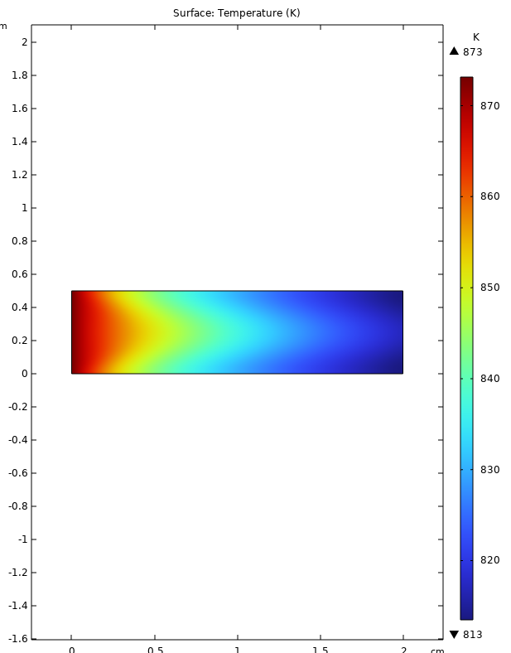
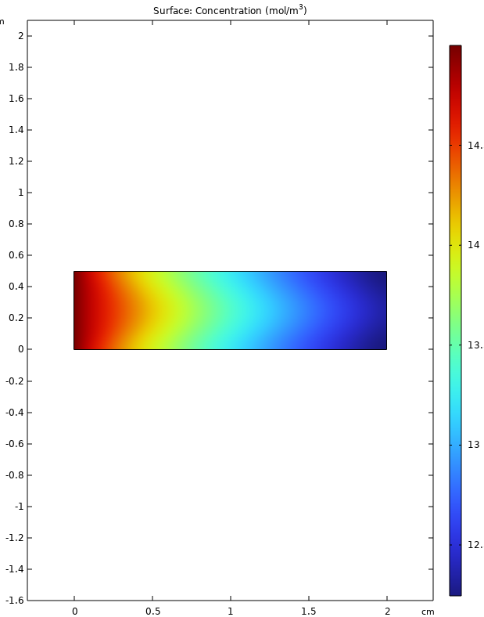

U=0.18,C_E=15
.

Slide 13
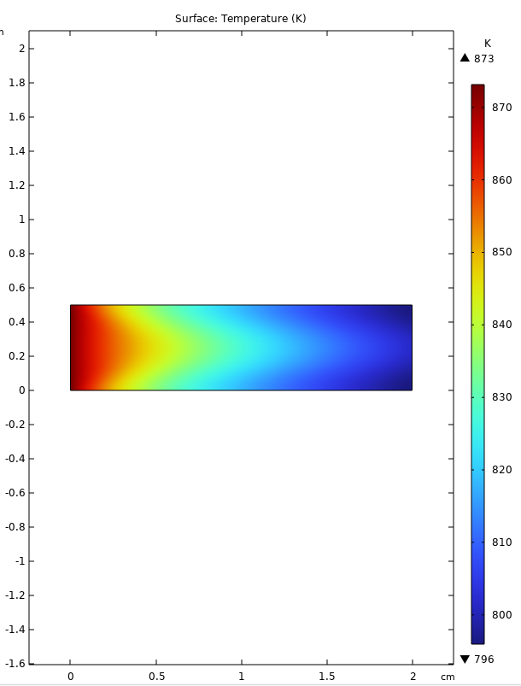

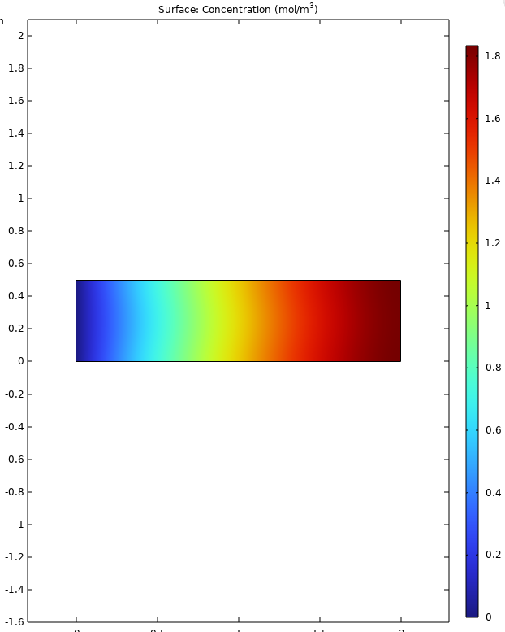
U=0.18,C_E=20 contour representation of TEMPERETURE, ETHANOL, HYDROGEN YIELD (from left)

Slide 14
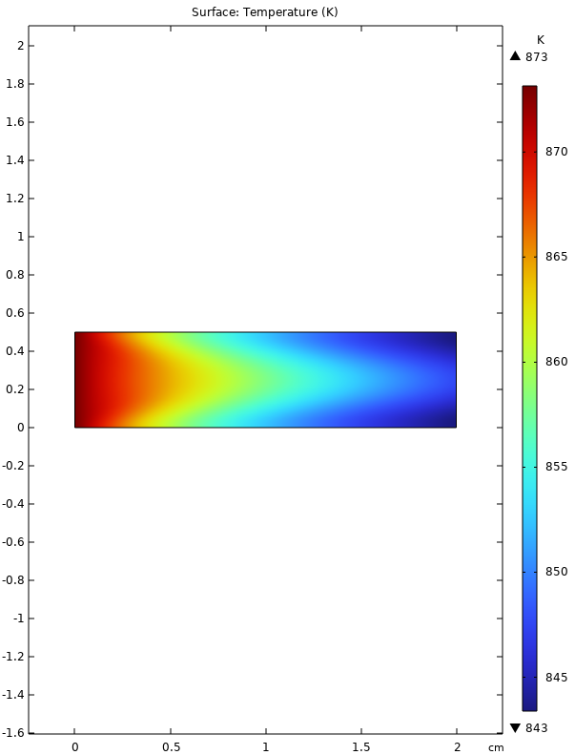
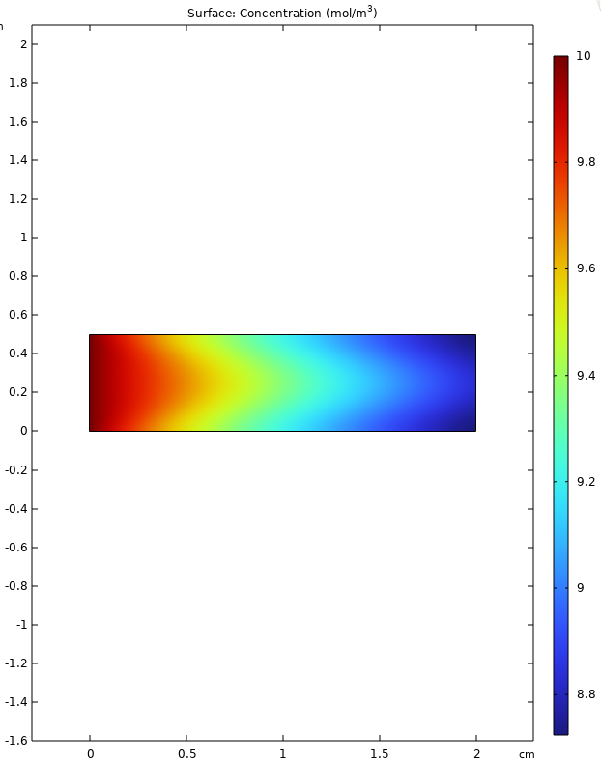
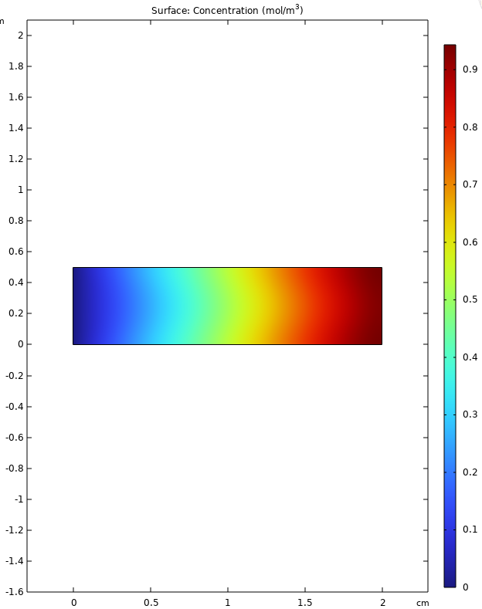
U=0.36,C_E=10

Slide 15
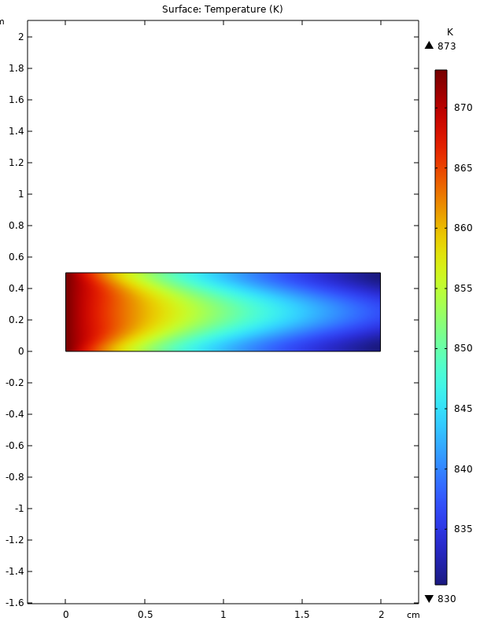
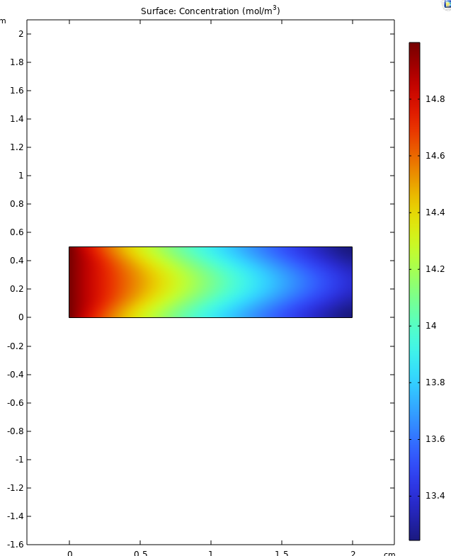
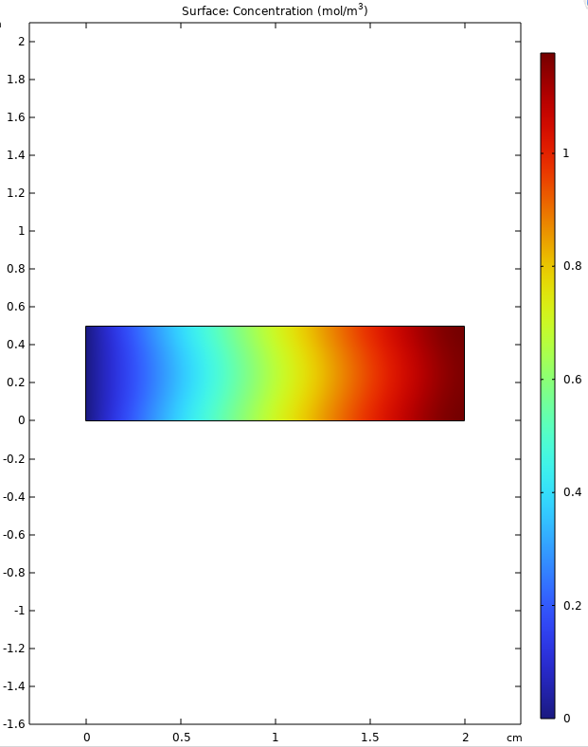
U=36,C_E=15

Slide 16
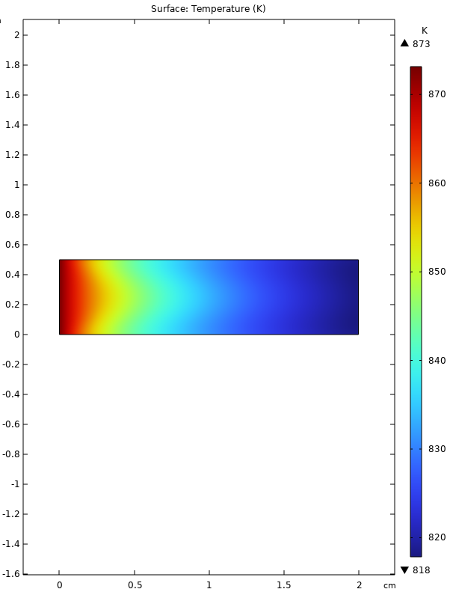
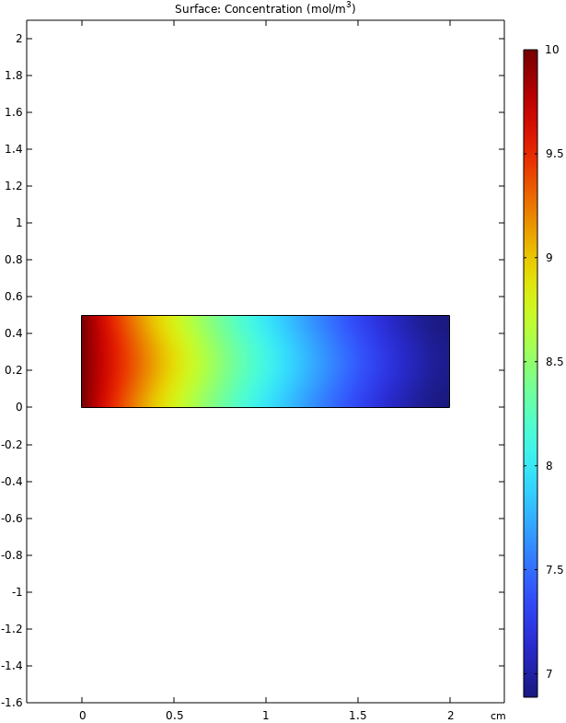
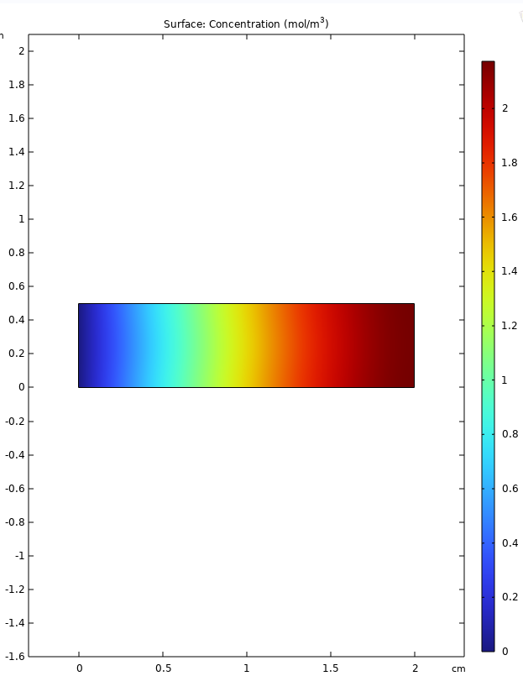
U=0.09 C_E=10

Slide 17
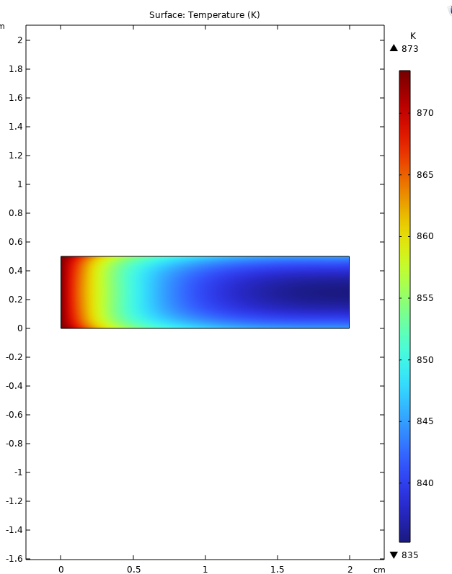
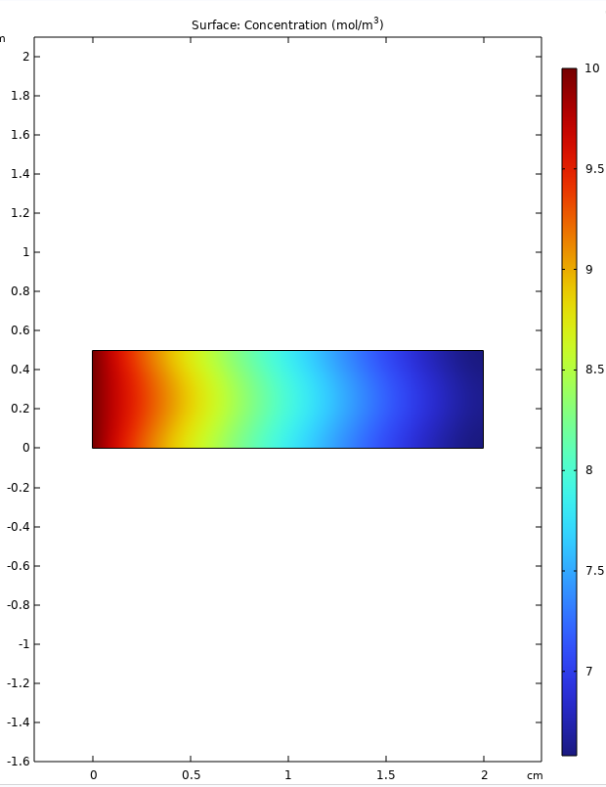
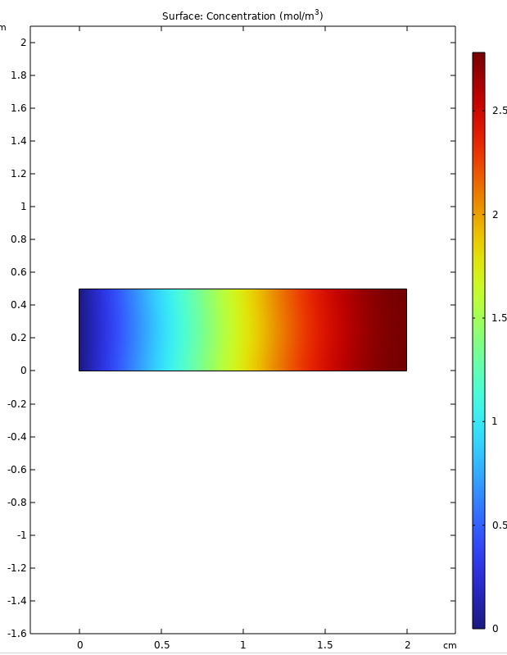
HEAT FLUX 500 U=0.09,C_E=10

Slide 18
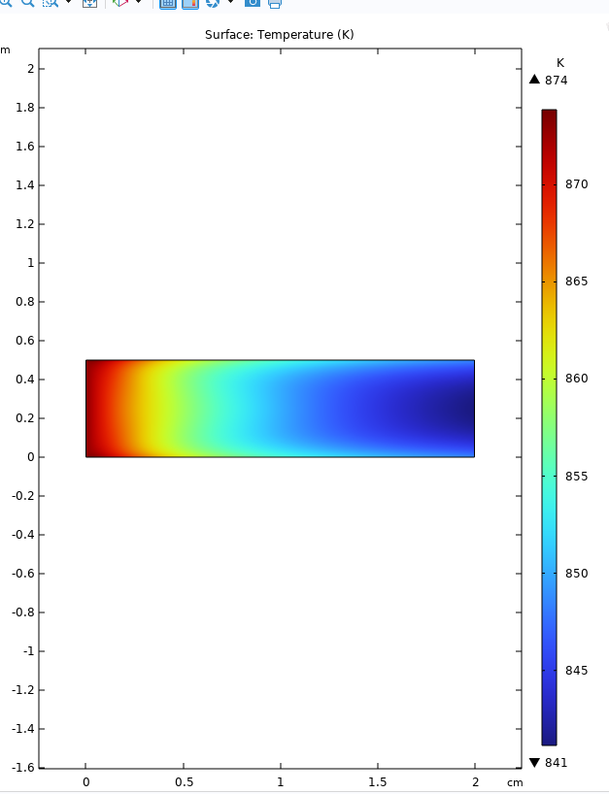
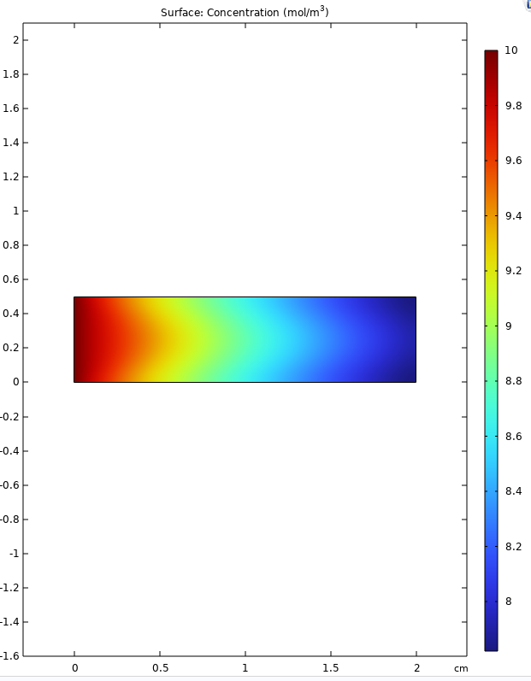
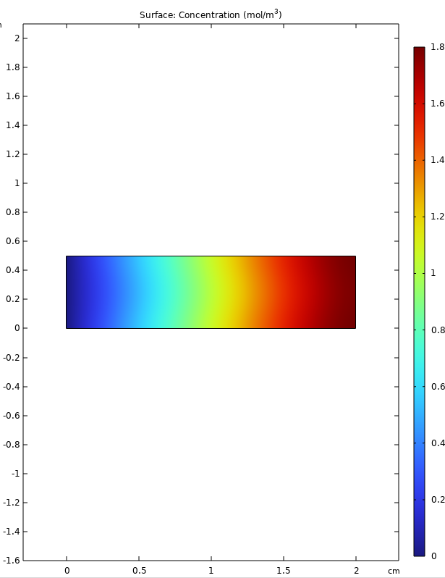
HEAT FLUX=500 U=0.18, C_E=10

Slide 19
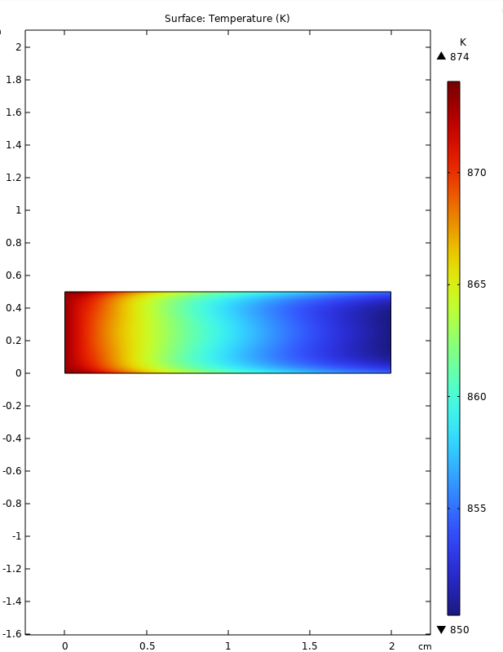
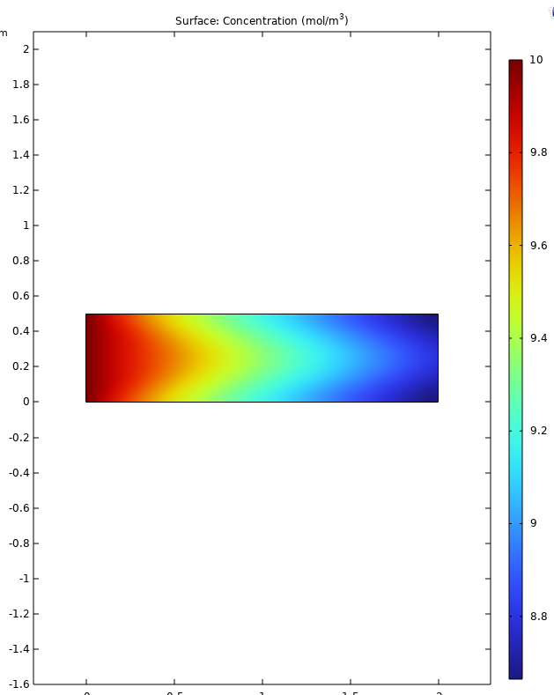
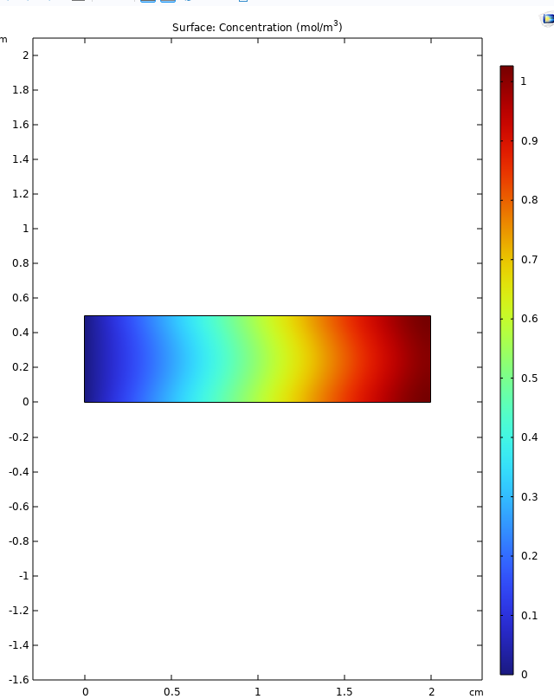
FLUX=500 U=0.36,C_E=10

Slide 20
Trends Without Heat Flux
At constant velocities 0.09, 0.18, and 0.36:
Increasing velocity reduces residence time, leading to lower ethanol conversion.
Lower velocity (0.09) results in better ethanol consumption and higher hydrogen production.
Temperature profiles shift with velocity; higher velocity tends to lower peak temperature.
Varying ethanol inflow concentration (10, 15, 20):
Higher ethanol concentration increases initial ethanol level and hydrogen production.
Ethanol concentration decreases more sharply along the reactor with higher feed concentration.
Temperature increases with ethanol concentration due to more exothermic reaction heat.

Slide 21
Trends Without Heat Flux
Effect of Changing Velocity (At Constant Ethanol Concentration)
Increasing velocity leads to:
Reduced hydrogen yield due to shorter residence time.
Temperature peak moves and lowers because of faster flow.
Less ethanol consumption as less time is available for reactions.

Slide 22
Trends With Heat Flux (100 W/m² and 500 W/m²)
Heat flux increases reactor temperature significantly.
Elevated temperature enhances ethanol conversion and hydrogen yield.
Hydrogen concentration profiles have steeper increases with higher heat flux.
Under heat flux, the same velocity and ethanol concentration trends hold but with improved yields and temperature levels.
Lower velocity and higher ethanol feed combined with heat flux produce highest hydrogen yield.

Slide 23
Condition | Parameter Changed | Temperature Profile | Ethanol Concentration Profile | Hydrogen Concentration Profile
Without Heat Flux | Constant velocity (0.09, 0.18, 0.36) | - Lower velocity leads to higher temperature peaks due to longer reaction time. - Higher velocity reduces peak temperature due to shorter residence time. | - Ethanol concentration decreases more significantly at lower velocity. - Higher velocity leads to less ethanol consumption. | - Hydrogen concentration increases more at lower velocity. - Higher velocity reduces hydrogen production due to limited reaction time.

Slide 24
Condition | Parameter Changed | Temperature Profile | Ethanol Concentration Profile | Hydrogen Concentration Profile
 | Ethanol Inflow Concentration (10, 15, 20) | - Higher ethanol concentration increases reaction heat, raising temperature peaks. | - Higher initial ethanol concentration; faster ethanol consumption trend. | - Hydrogen yield increases with higher ethanol feed concentration.
Effect of Changing Velocity | Velocity changes at constant Ce | - Increasing velocity lowers temperature peaks. - Temperature profile shifts downstream. | - Ethanol consumption less with higher velocity. - Concentration gradient flattens. | - Hydrogen production reduces with increasing velocity. - Maximum hydrogen concentration lowers.

Slide 25
Condition | Parameter Changed | Temperature Profile | Ethanol Concentration Profile | Hydrogen Concentration Profile
With Heat Flux (100 and 500 W/m²) | Heat flux variation | - Heat flux significantly increases temperature levels. - Higher flux leads to steeper temperature gradients. | - Ethanol consumption rate increases with heat flux due to higher temperatures. | - Hydrogen concentration rises significantly with increased heat flux. - Steeper rise and higher maximum hydrogen yield.
 | Combined velocity and Ce under heat flux | - Trends similar to no flux case but with larger temperature magnitudes. - Highest temperatures at low velocity and high ethanol concentration. | - Ethanol consumption is enhanced by heat flux. - Decreases faster along reactor length under high heat and low velocity. | - Hydrogen production maximized with heat flux combined with low velocity and high ethanol concentration. - Highest observed hydrogen yields.

Slide 26
Hydrogen Yield Optimization
Low inlet velocity increases residence time, leading to more complete ethanol conversion and higher hydrogen yield.
High ethanol feed concentration supplies more reactant, directly boosting hydrogen production.
Applying a high heat flux raises reactor temperature, speeds up reaction kinetics, and enhances hydrogen generation.
The best hydrogen yield is achieved by combining low velocity, high ethanol concentration, and sufficient heat input in the reactor.
These optimized conditions result in efficient ethanol consumption and favorable temperature and hydrogen profiles.

